Slide 1

KOOKAÏ
Brand Equity Analysis & Growth Strategy
A Customer-Based Brand Equity study of an Australian fashion label —
where it earns loyalty, where it excludes, and how it grows.
Louisa Zhang

Slide 2
BRAND SNAPSHOT
A Parisian-inspired label built on quiet exclusivity
$86.7M
900K
90%
18–35
2025 revenue,
Australian market
combined Instagram
& TikTok following
of production
vertically integrated
core target
age range
Kookai is an Australian-owned, Parisian-inspired fashion label serving fashion-forward women 18–35 with elegant, feminine essentials. It competes on accessible luxury — sophisticated design at a more attainable price than premium designers.
KOOKAI — BRAND EQUITY ANALYSIS
2

Slide 3
MARKET POSITION
Positioned at the intersection of quality and price
Ajé
Scanlan Theodore
Where Kookai sits
Henne
High quality, mid-to-premium price — above Zara and Cotton:On, below Ajé and Scanlan Theodore.
Sits in the most contested part of the map, where quality and price expectations overlap most directly with competitors.
Differentiation currently rests on aesthetic and ethics — not yet on who the brand serves.
Kookai
Zara
Witchery
Cotton:On
Glassons
Dissh
Sézane
KOOKAI — BRAND EQUITY ANALYSIS
3

Slide 4
FRAMEWORK
Reading Kookai through Keller’s CBBE Pyramid
Salience
Awareness — who thinks of Kookai, and when
Performance & Imagery
What the product delivers, and what it signals
Judgements & Feelings
Credibility, quality, social approval, emotional response
Resonance
Loyalty, community, active engagement
Kookai performs strongly at the base and middle of the pyramid — but the analysis below finds its steepest drop-off at Judgements: the brand is well-known and well-made, but not perceived as being made for everyone.

Slide 5
STRENGTHS
What Kookai gets right
Sensory, recognisable retail experience
Ethical, vertically integrated production
Minimalist marble-and-wood boutiques paired with a signature scent, ‘Oui Non’ — lifting purchase intent by 60% and in-store dwell time by 18%.
~1,000 staff across 3 factories in Fiji and Sri Lanka, founded on the belief of founder Rob Comb to bring prosperity back to the community he grew up in.
Consistent, durable quality
Purpose consumers can feel
Consumers report garments lasting years without wear — building trust in a category known for disposability.
The Katalyst Foundation channels 100% of core-collection proceeds into poverty relief in Fiji, deepening emotional connection to the brand.
KOOKAI — BRAND EQUITY ANALYSIS
5

Slide 6
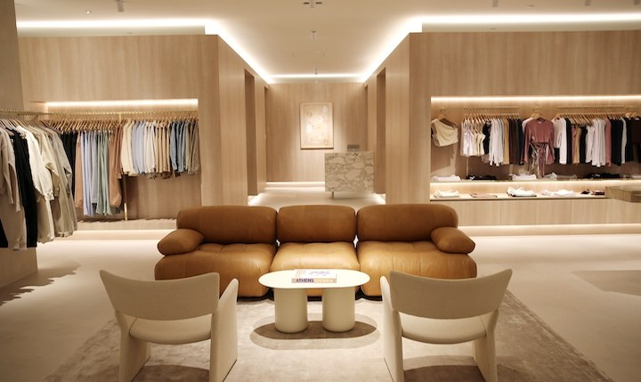
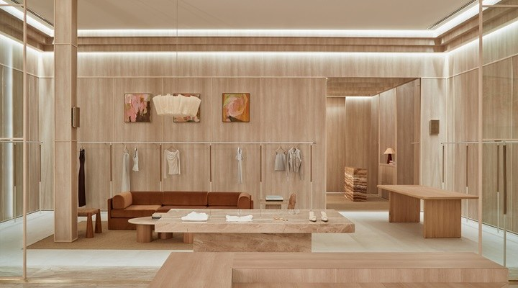
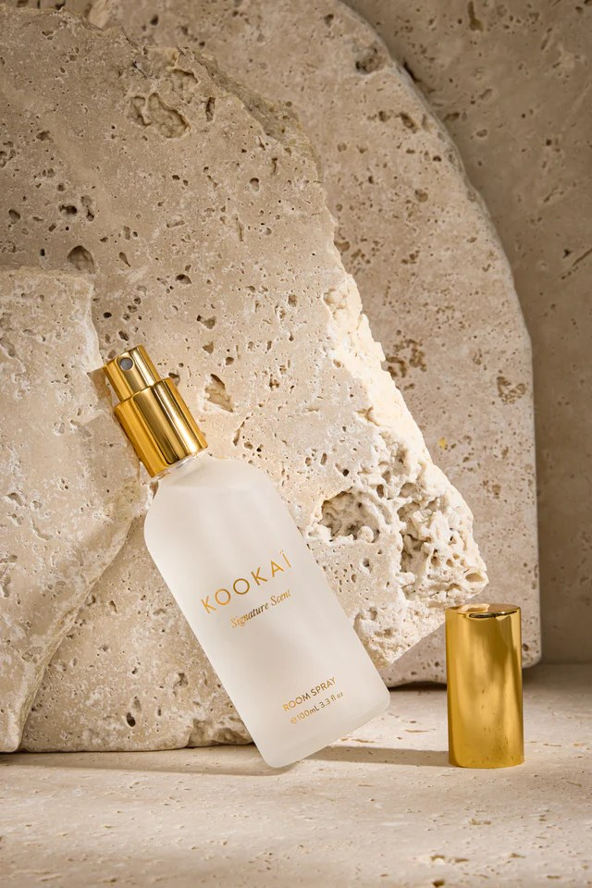
IN STORE
Where the brand equity is felt first-hand
The signature scent, ‘Oui Non’ — shown here as the take-home room spray — is the same fragrance diffused through every boutique, turning a sensory cue into a brand asset customers can buy and keep.
KOOKAI — BRAND EQUITY ANALYSIS
6

Slide 7
THE CORE GAP
One judgement problem undercuts everything above it
14
16
37%
Largest size Kookai
currently offers (AU)
Size the average
Australian woman wears
of Australian women
are considered plus-size
Kookai's sizing and casting exclude more than a third of the Australian market it sells to — and its campaigns feature almost no racial diversity. This is the brand's clearest gap between what it delivers and who it welcomes.

Slide 8
FINANCIAL SIGNAL
Revenue has softened as the market moved on
$86.7M
Reported 2025 revenue — down from $100.8M in 2022
The decline lines up with the same period the brand's exclusivity became harder to ignore. A narrow size range and homogenous casting cap the addressable market precisely as competitors court a broader one.
KOOKAI — BRAND EQUITY ANALYSIS
8

Slide 9
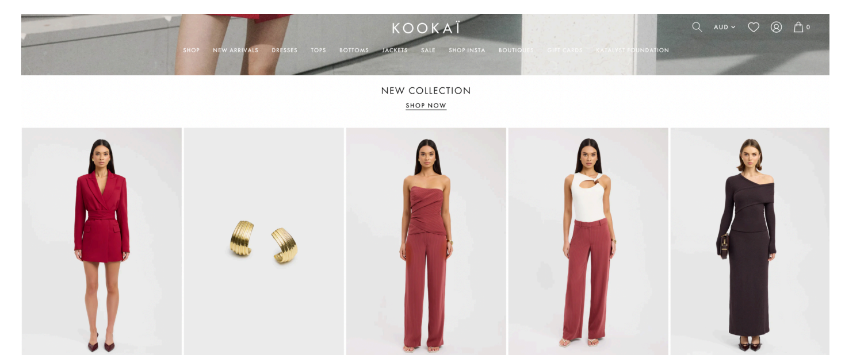
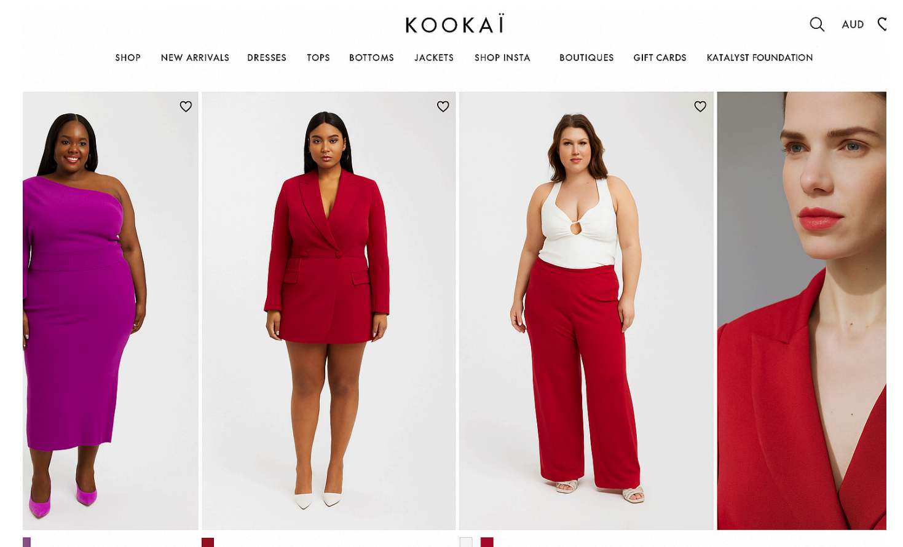
RECOMMENDATION 01
‘Kookai Ensemble’ — inclusive by design, not exception
Today
Reimagined
Strategic: Rebrand around size and colour representation, preserving Kookai's elegance and femininity while broadening who it's for.
Tactical: An integrated ‘Ensemble’ campaign across store and digital — plus-size mannequins, diverse casting, and a collaboration with the All Women Project.
KOOKAI — BRAND EQUITY ANALYSIS
9

Slide 10
RECOMMENDATION 02
‘Katalyst Club’ — turn advocates into members
Entry
Insider
Katalyst
Points for every purchase and social share
Early access to new drops and styling sessions
VIP events, co-creation votes, exclusive pieces
Reward user-generated content — Hashtag and repost incentives turn Kookai's already-active fanbase into a structured source of authentic content and trust.
Seed body-positive creators — PR to Australian influencers across sizes and backgrounds signals inclusivity is genuine, not campaign-deep.
Open the door to co-creation — Higher tiers vote on upcoming pieces — giving loyal members a sense of ownership in what Kookai makes next.
KOOKAI — BRAND EQUITY ANALYSIS
10

Slide 11
EXPECTED IMPACT
Fix the gap, keep the elegance
1
Reopens a market Kookai currently locks out — the 37% of Australian women it doesn't dress.
2
Deepens resonance by giving loyal consumers a community, not just a store.
3
Protects the brand's core DNA of sophistication and femininity throughout.
4
Directly addresses the judgement gap most likely behind the recent revenue decline.
Louisa Zhang — Brand Equity Analysis & Growth Strategy

