Slide 1
A CUSTOMER EXPERIENCE JOURNAL
Alba
Mapping the guest journey through an Australian
geothermal retreat — where it delivers, where it breaks
down, and how it can deepen loyalty.
Louisa Zhang
Customer Experience & Journey Mapping

Slide 2
02
BRAND SNAPSHOT
A modern geothermal retreat in
regional Victoria
6th
$5,000
22
18–35
Australia's global rank
in wellness spend
average annual wellness
spend per Australian
geothermal pools
on site
core Gen Z &
Millennial target
Alba Thermal Springs is a Victorian geothermal spa retreat built on tranquility through prestige and innovation — natural mineral pools, restorative treatments, and a personalised, phone-free guest experience.
ALBA THERMAL SPRINGS · CUSTOMER EXPERIENCE JOURNAL
02

Slide 3
03
WHO WE'RE MAPPING FOR
Sophie — 25, Melbourne
marketing manager
GOALS
FRUSTRATIONS
CHANNELS
A place to relax and unwind from daily life
Digital detox away from email and messages
Physical restoration and a luxurious experience
Dislikes overcrowded spaces
Wants incentives and loyalty programs
Expects the digital experience to be seamless
Discovers new wellness brands on TikTok
Follows aesthetic, aspirational content on Instagram
Trusts influencer recommendations over ads
Sophie represents Alba's highest-potential segment: young, urban, wellness-driven, and willing to pay for perceived luxury — but she expects that luxury to feel effortless, both in person and online.
ALBA THERMAL SPRINGS · CUSTOMER EXPERIENCE JOURNAL
03

Slide 4
04
FRAMEWORK
Six stages, one continuous
guest journey
1
2
3
4
5
6
Awareness
—
Information
Search
—
Check-In
—
Dining
—
Spa
—
Post-
Experience
Each stage was assessed for what Sophie sees, feels, and does — surfacing where Alba delivers on its promise of tranquility, and where friction breaks the spell.
ALBA THERMAL SPRINGS · CUSTOMER EXPERIENCE JOURNAL
04

Slide 5
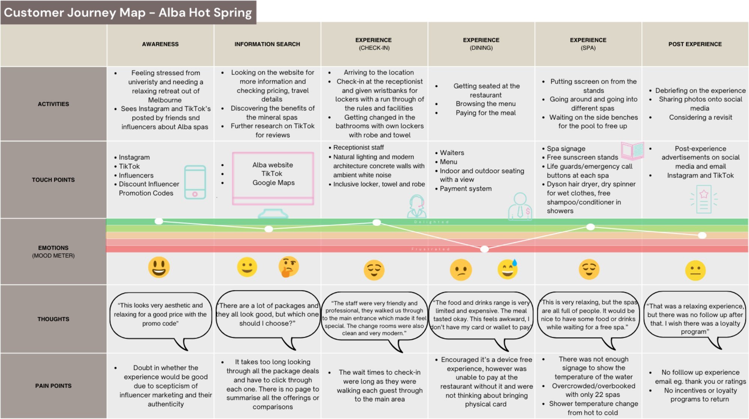
THE MAP
The guest journey, mapped end to end
Figure — Alba Customer Journey Map
ALBA THERMAL SPRINGS · CUSTOMER EXPERIENCE JOURNAL
05

Slide 6
06
WHERE IT BREAKS DOWN
Small frictions undercut a
premium experience
2
22
0
separate trips guests must make
just to pay for a meal
geothermal pools, frequently
overcrowded with no capacity limit
follow-up emails, surveys, or
loyalty prompts after checkout
None of these are dealbreakers on their own — but together they chip away at the sense of effortless luxury Alba is trying to sell, right at the moments guests are most primed to notice.

Slide 7
07
VOICE OF THE GUEST
What guests are already saying
“
“
“
The only set back was waiting in the line at reception when we first enter — but it was worth it at the end.
Signage and wayfinding is poor... they really need a cold pool to balance the very hot thermal pools.
The food is grossly overpriced. Very nice cuisine on offer, but the price point is double what it should be.
Mel F. — Google review, 5/4
Verified guest — Google review
Verified guest — Google review
ALBA THERMAL SPRINGS · CUSTOMER EXPERIENCE JOURNAL
07

Slide 8
08
RECOMMENDATIONS
Seven fixes, mapped to the journey
Launch an official TikTok
Add a package comparison tool
Close the gap left by fan and influencer content with a verified, on-brand presence.
Let guests filter by price, treatment, and duration instead of clicking through every page.
Digital check-in kiosks
RFID wristband payments
Cut wait times with sensory distractions — music, scent, and tea — while queues move.
Let guests pay poolside without breaking the phone-free policy or leaving the spa.
Live spa signage
Post-visit loyalty prompts
Digital temperature displays and capacity limits reduce crowding and mismatched expectations.
Follow-up emails inviting guests to rate their stay, refer a friend, and join the loyalty program.
ALBA THERMAL SPRINGS · CUSTOMER EXPERIENCE JOURNAL
08

Slide 9
09
SPOTLIGHT RECOMMENDATION
An Alba loyalty program
guests can level up
Healthy Novice
Wellness Superstar
Relaxation Guru
20 POINTS
50 POINTS
100 POINTS
$10 off your next visit
Free add-on massage treatment
Access to the VIP spa lounge
WAYS TO EARN POINTS
Refer a friend — 5 points
Every spa visit — 10 points
Complete the guest survey — 2 points
Every meal purchased — 10 points
Share a post tagging Alba — 5 points

Slide 10
10
EXPECTED IMPACT
Close the small gaps, protect
the tranquility
01
Reduces friction at the three moments guests are most likely to notice it.
02
Turns a one-time visit into a repeat relationship through loyalty and follow-up.
03
Builds an owned digital presence instead of relying on fan-made content.
04
Protects Alba's core promise — tranquility through prestige — while it scales.
Louisa Zhang · Customer Experience & Journey Mapping

Slide 11
Appendix
A
Guest Reviews
B
Social Search
Additional Google review excerpts
What guests find searching Alba on TikTok
C
Website Experience
D
Loyalty Program Guide
The current package browsing flow
Full tier and point-earning detail

Slide 12
12
APPENDIX A
Additional guest review excerpts
“
“
“
As outlined by others, signage and wayfinding is poor. Pools don't vary in temperature — they really need a cold pool to balance the very hot thermal pools. More shade would help for the sunny days.
The staff in the restaurant, by contrast to the desk, were rude and pretentious and treated you like an imposition. This was most disappointing. The food is grossly overpriced for what's on offer.
This could be a great place for festivals and music concerts. The parking lot capacity is enormously huge — perfect for an outdoor theatre, picnic, or barbecue. Wish I had the power to do such business.
Verified guest — Google review
Verified guest — Google review
Sultan G. — Local Guide, Google review
ALBA THERMAL SPRINGS · CUSTOMER EXPERIENCE JOURNAL
12

Slide 13
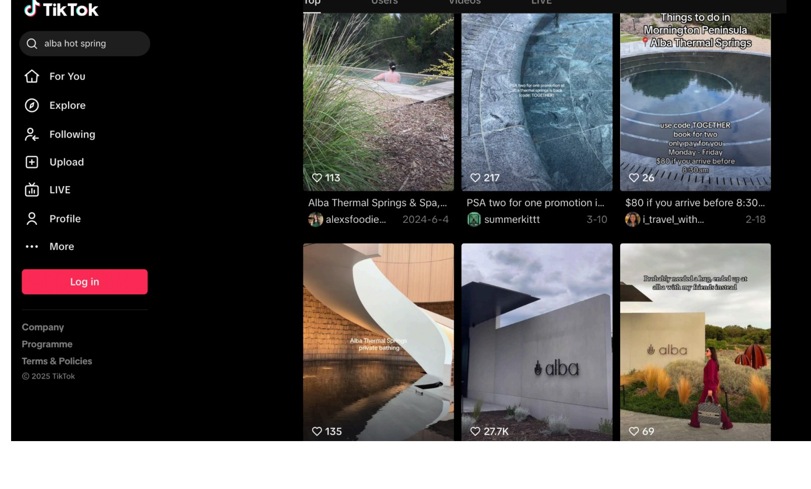
13
APPENDIX B
Searching ‘Alba hot spring’ on TikTok
Every result is user-generated or influencer content — there is no verified Alba account for guests to follow, unlike its verified Instagram.
ALBA THERMAL SPRINGS · CUSTOMER EXPERIENCE JOURNAL
13

Slide 14
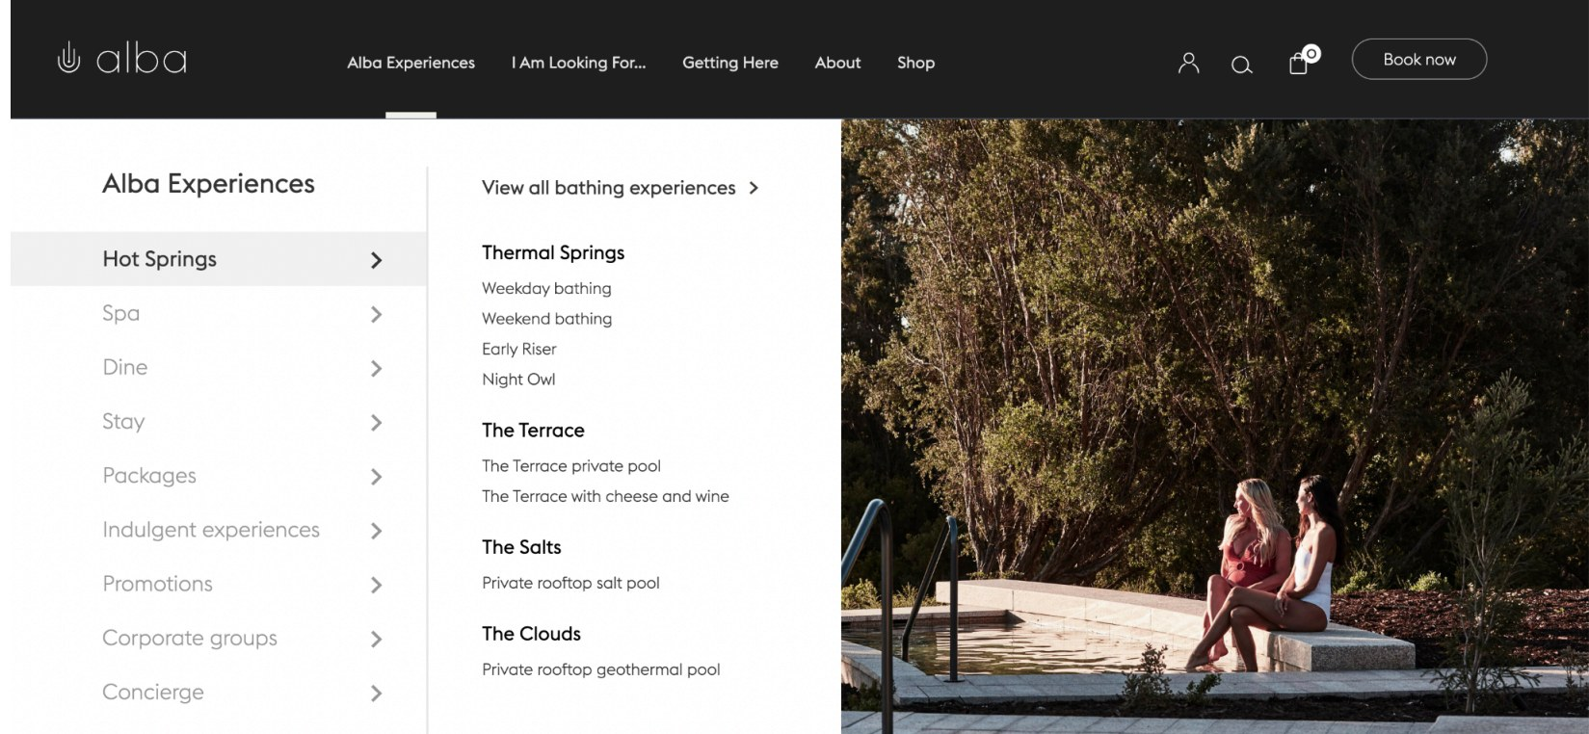
14
APPENDIX C
Poor Information Architecture
Hot Springs, Spa, Dine, Stay, and Packages each open a separate page with no summary view — the source of the information-search pain point.
ALBA THERMAL SPRINGS · CUSTOMER EXPERIENCE JOURNAL
14

Slide 15
15
APPENDIX D
Alba loyalty program — full guide
MEMBERSHIP TIERS
POINT REDEMPTION
Stage | Points | Reward
Healthy Novice | 20 points | $10 off next visit
Wellness Superstar | 50 points | Free add-on massage treatment
Relaxation Guru | 100 points | Access to VIP spa lounge
Action | Points
Refer a friend | 5 points
Every spa visit | 10 points
Complete the survey | 2 points
Every meal purchased | 10 points
Share a post tagging Alba | 5 points
ALBA THERMAL SPRINGS · CUSTOMER EXPERIENCE JOURNAL
15

